Slide 1
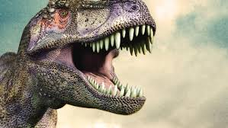
To be
OR
NOT TO BE

Slide 2
dinosaurs share MORE THAN 50 characteristics
?
Long, low deltopectoral crest on humerus
Glenoid faces caudally
Femur with a ball-shaped head
Proximal articulation of the calcaneum is concave
Supracetabular buttress present
Brevis fossa on pelvis
Ascending process on the astragalus

Slide 3
3 Easy characteristics to remember:
Hips and shoulders place legs directly beneath animal
Evolved to inhabit terrestrial ecosystems
Lived during the Mesozoic Era

Slide 4
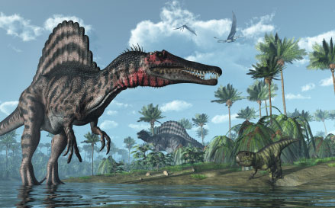
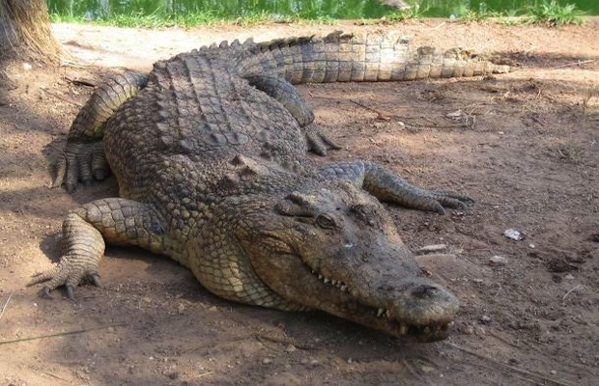
Hips/pectoral girdle place legs directly beneath animal
More vertical structure of the pectoral girdle and hips, hinge-like ankles
Positions limbs directly under body
….Not

Slide 5
Like a Sprinter

Slide 6
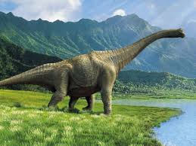
Evolved to inhabit terrestrial ecosystems
Spent the majority of their lives on land.
With an Exception…

Slide 7
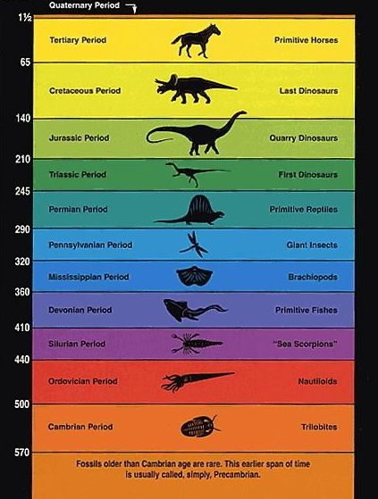
Lived during Mesozoic Era
End of the Cretaceous (~66.5 mya)
Dinosaurs show up in the fossil record ~230 mya
From the beginning of the Triassic (~245 mya)
165 million years dinosaurs ruled the Earth

Slide 8
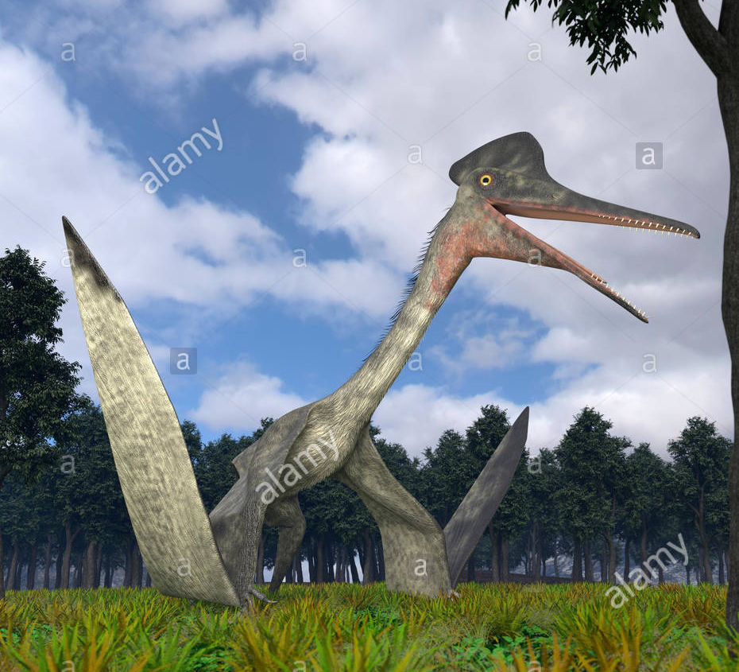
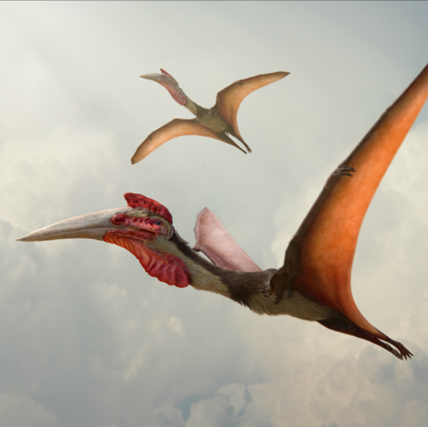
Quetzalcoatlus
Lived from Triassic through Cretaceous
Shoulders and hips place
legs beneath body
Adapted for life on land

Slide 9
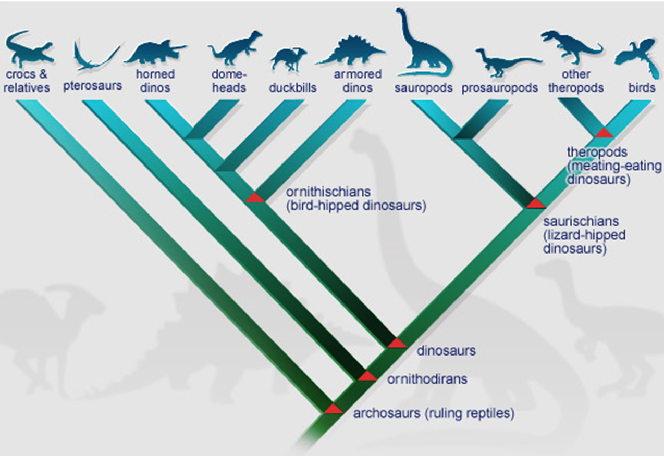
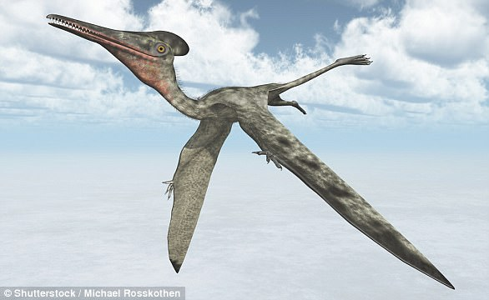
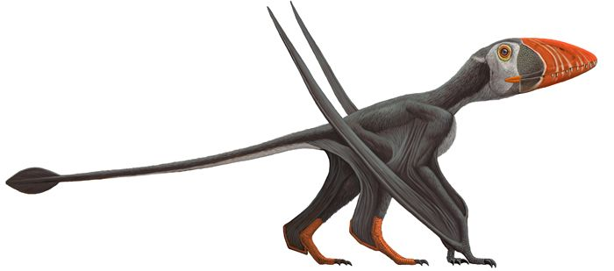
Pterosaurs
Close relatives to dinosaurs
Dinosaur Cladistics

Slide 10
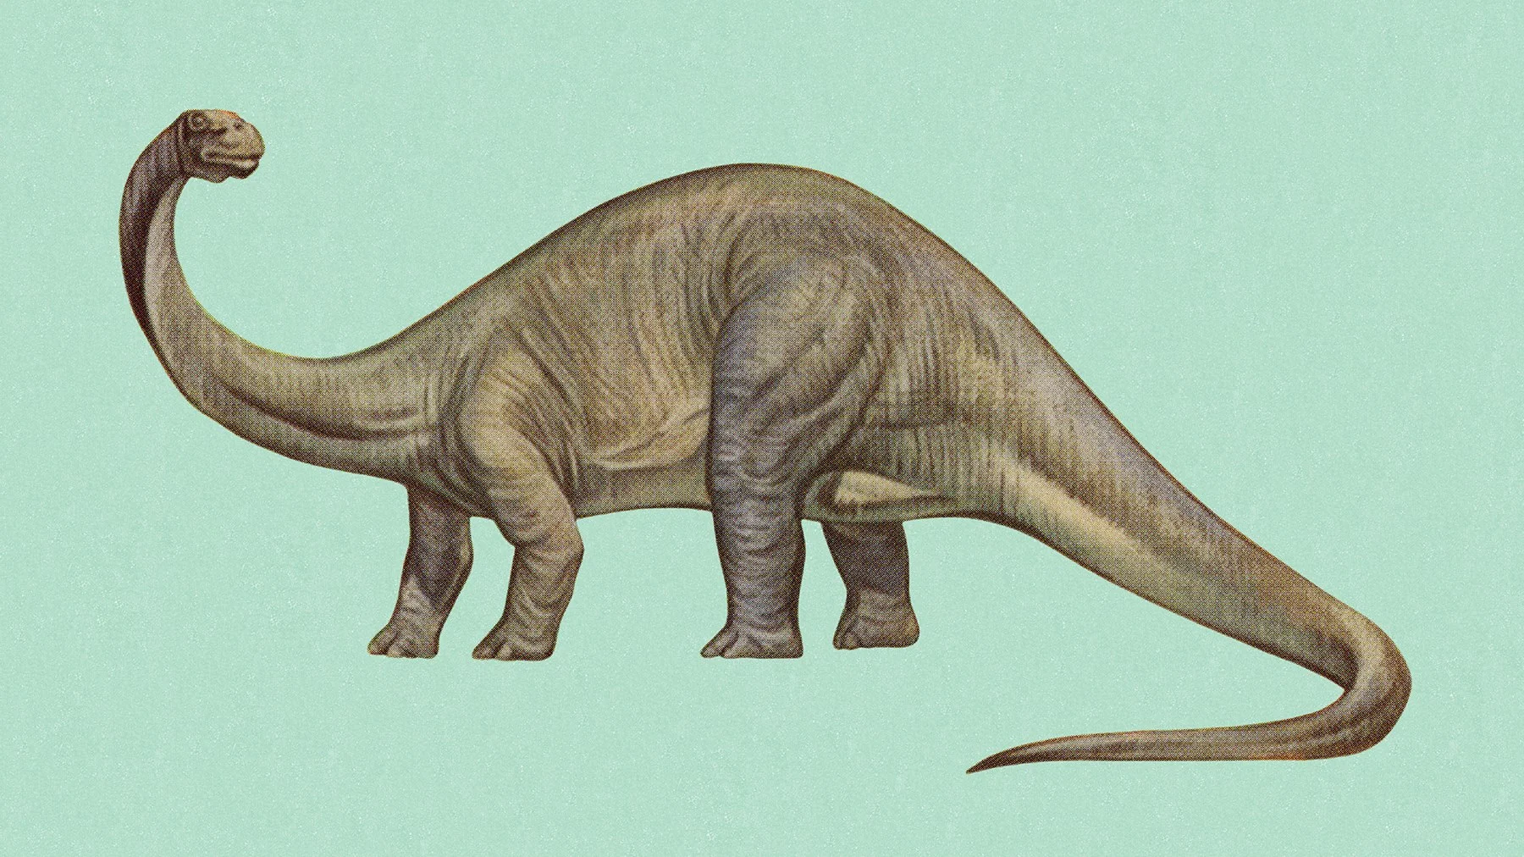
brontosaurus
Lived during Jurassic Period
Shoulders and hips place
legs beneath body
Adapted for life on land
Did Brontosaurus really exist?

Slide 11
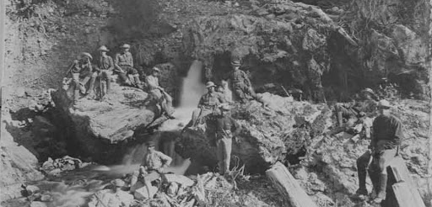
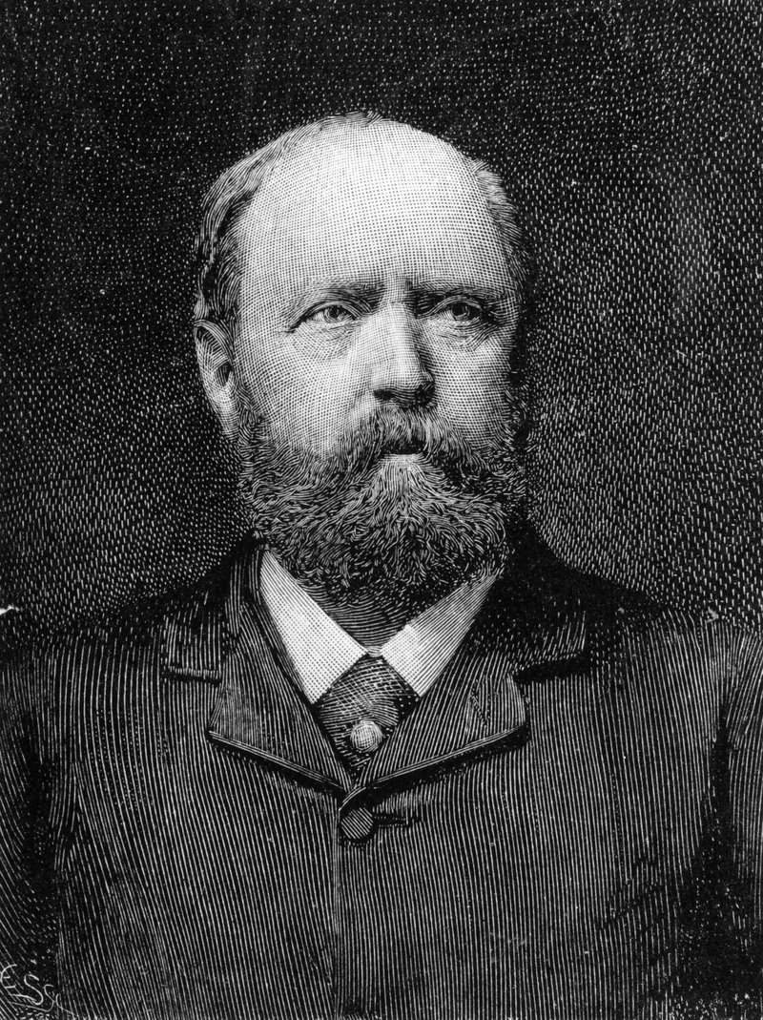
Bronto-gate
Brontosaur
or Apatosaur?
O.C. Marsh

Slide 12
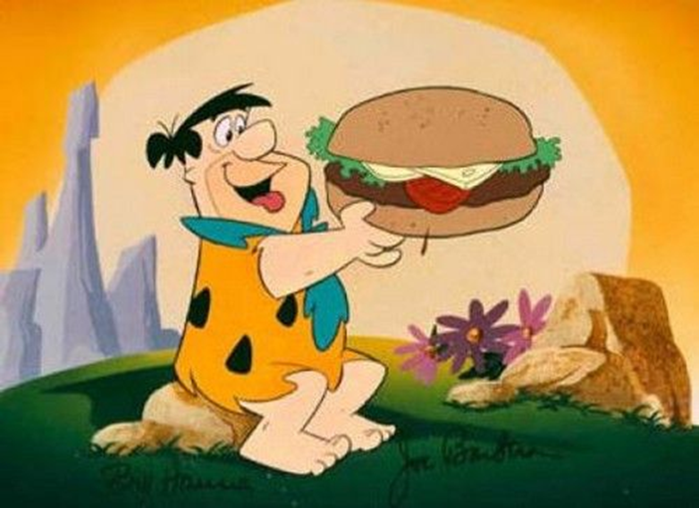
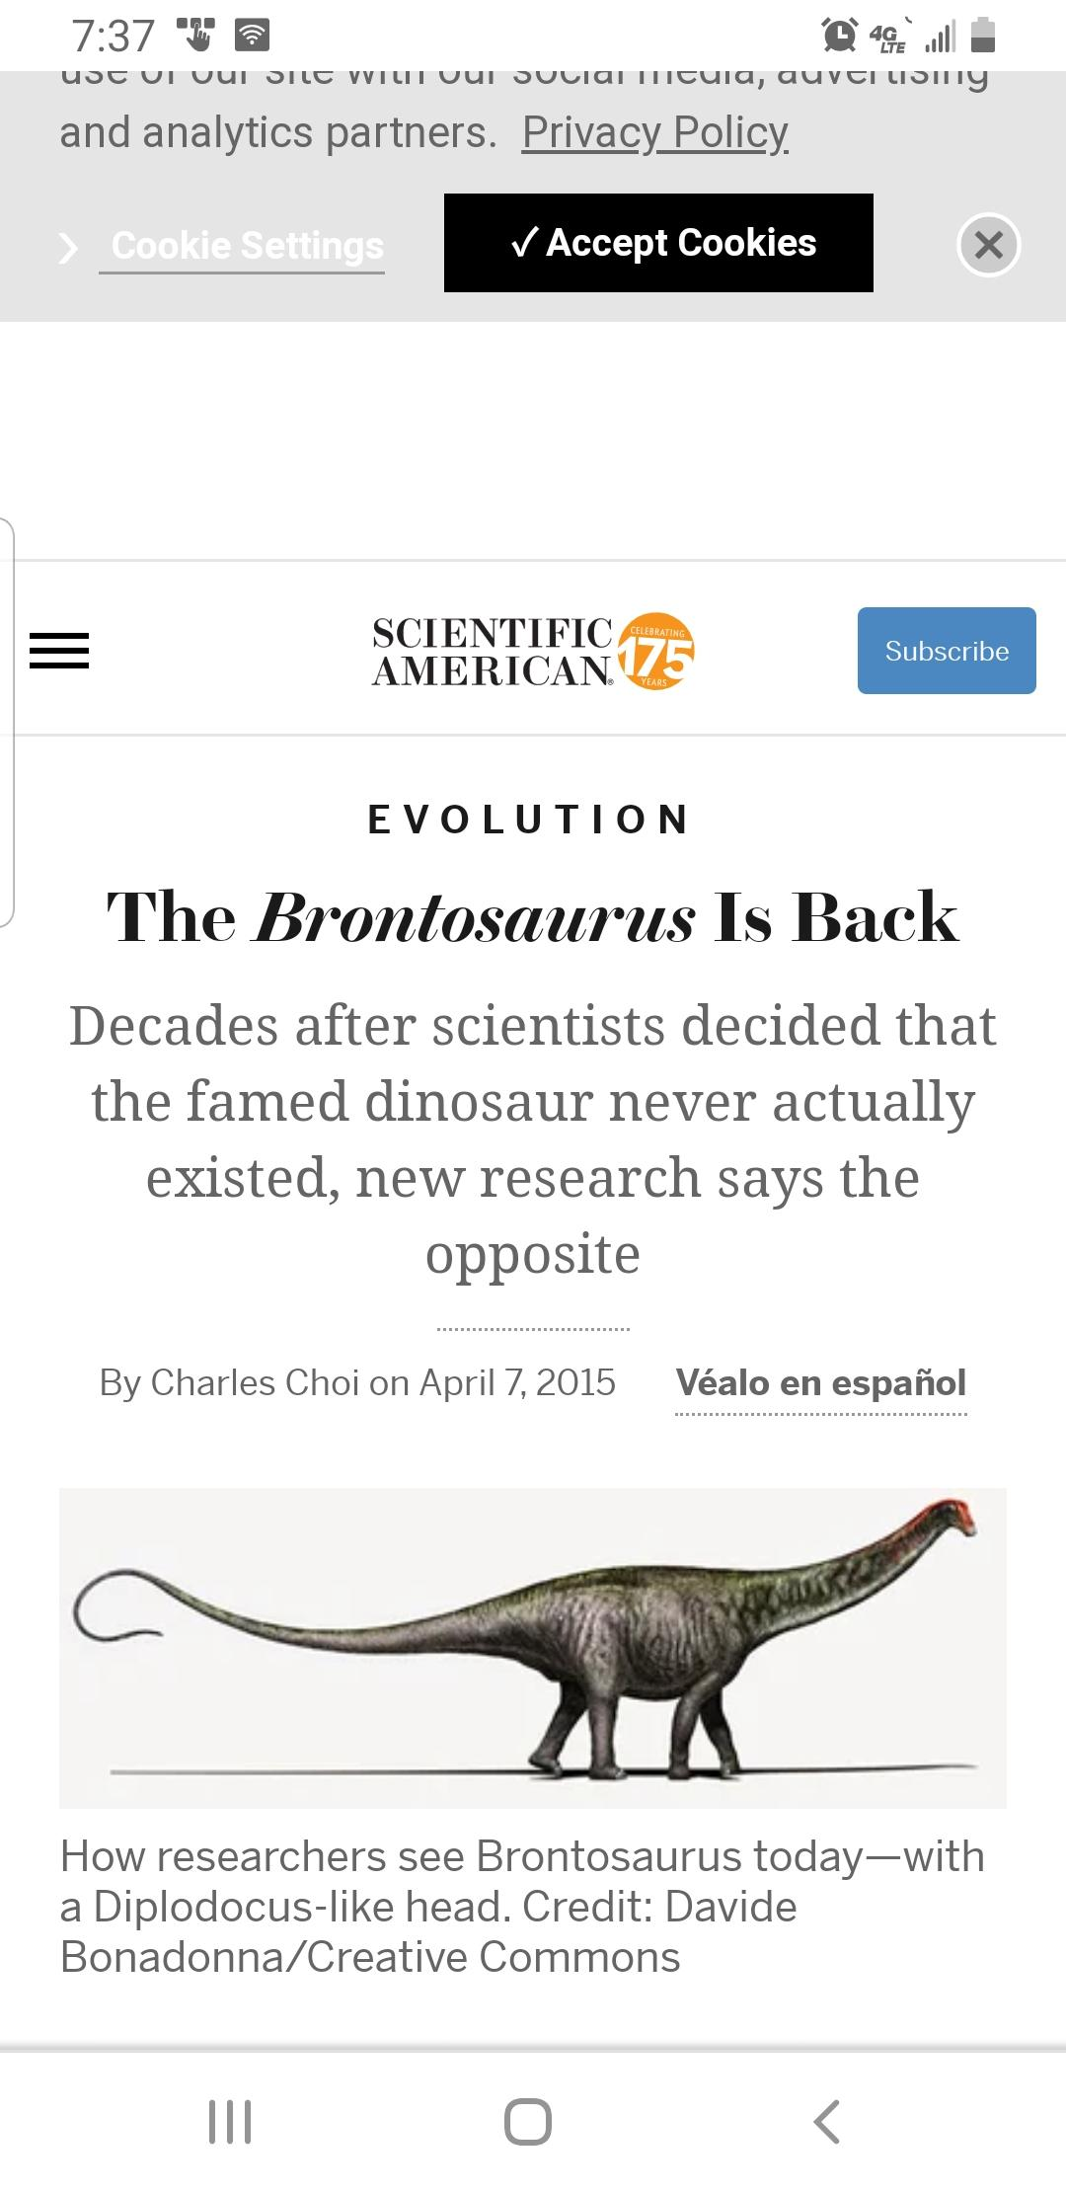
Bronto-gate
In 1903
In 2015

Slide 13
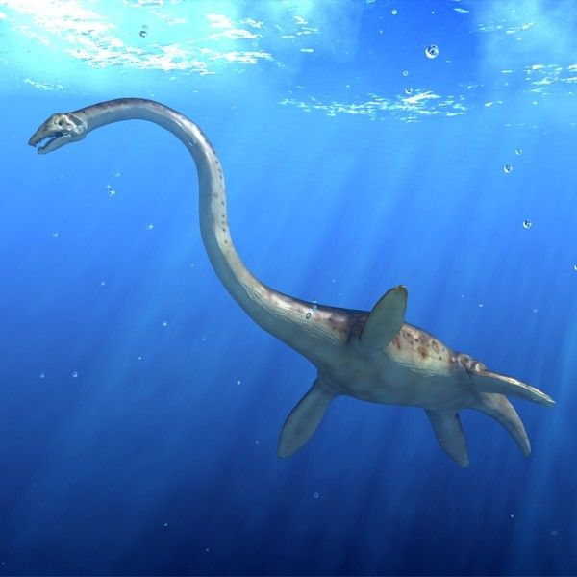
Plesiosaur
Lived during Cretaceous Period
Shoulders and hips place
legs beneath body
Adapted for life on land

Slide 14
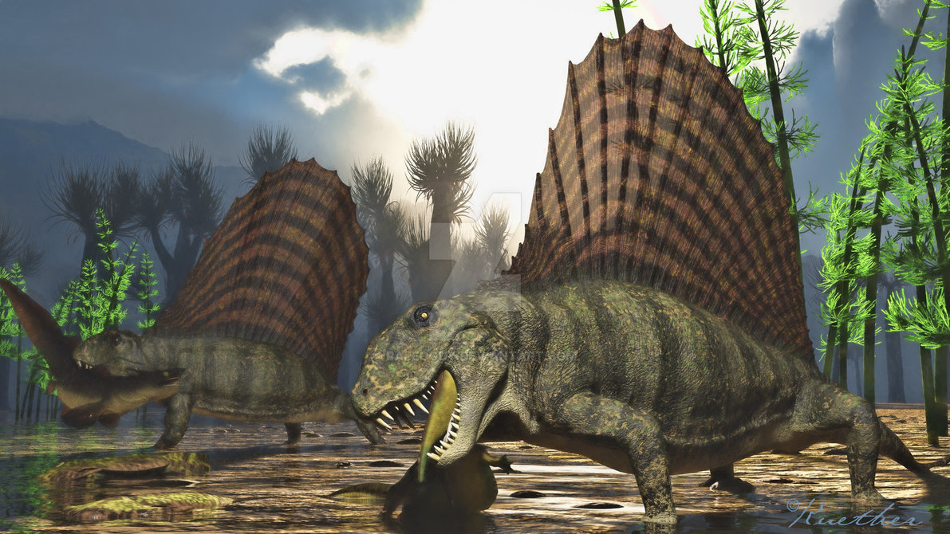
dimetrodon
Lived during Permian Period
Shoulders and hips place
legs beneath body
Adapted for life on land
Permian extinction-massive volcanic eruptions
Over 90 % of all species went extinct
Opened the door for dinosaurs

Slide 15
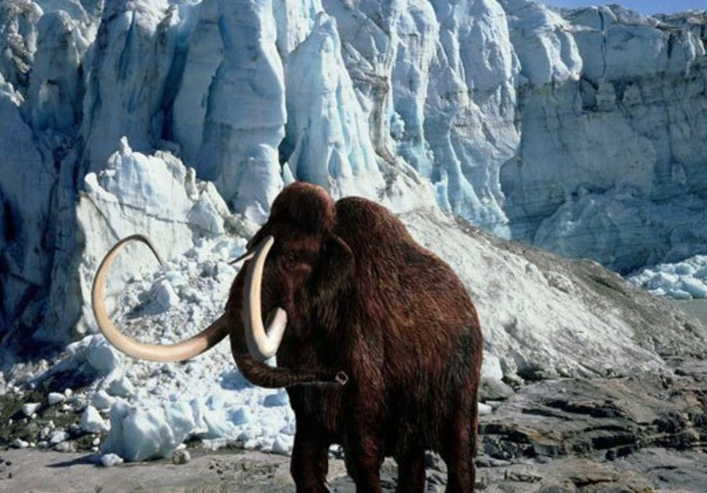
Wooly mammoth
Lived during Pleistocene Period
Shoulders and hips place
legs beneath body
Adapted for life on land

Slide 16
Mammoths
Appeared in Africa 3-4 million years ago
Several species throughout Asia
Crossed to North America about 36,000 years ago
Went extinct around 12,000 years ago

Slide 17
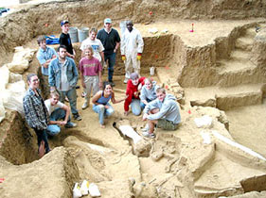
Bennie found on Principia college campus

Slide 18
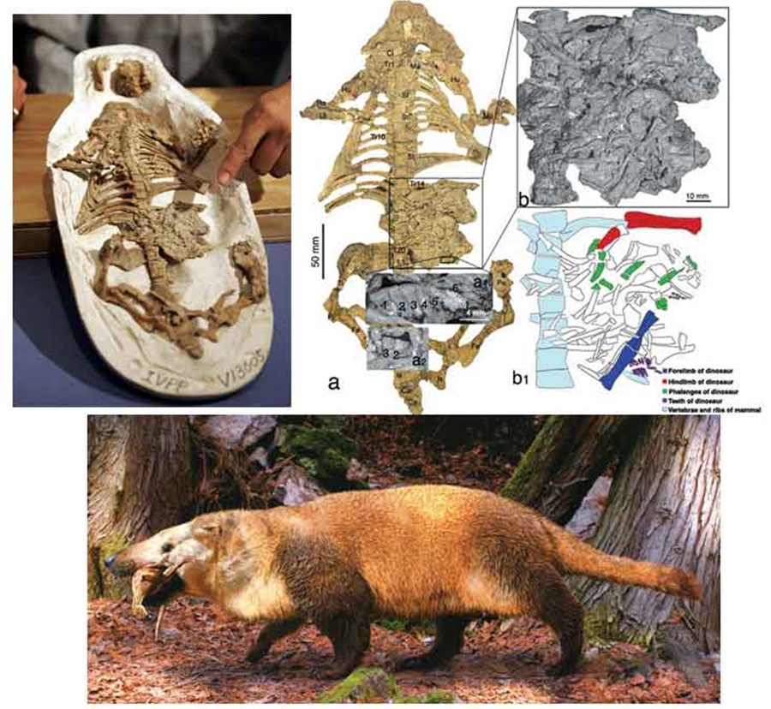
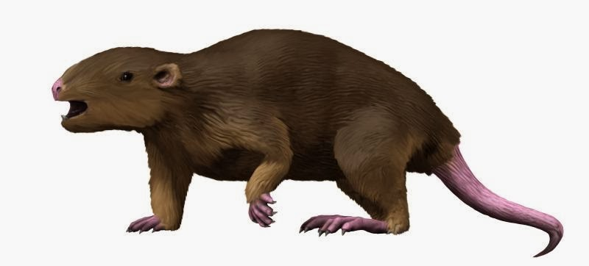
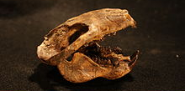
Mesozoic Mammals?
Relatively small
Probably night feeders
One fossil with dinosaur skeleton in stomach

Slide 19
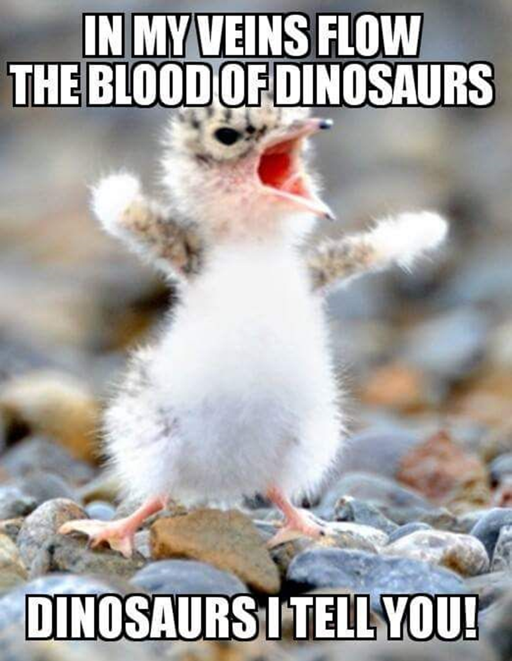
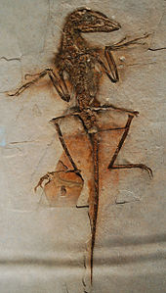
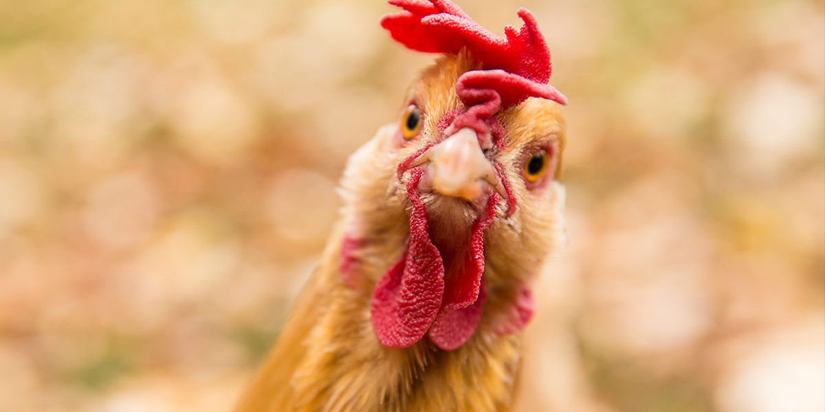
What’s missing?
Are Birds Really Dinosaurs?
Ask your average paleontologist who is familiar with the phylogeny of vertebrates and they will probably tell you that yes, birds (avians) are dinosaurs. Using proper terminology, birds are avian dinosaurs; other dinosaurs are
non-avian dinosaurs, and (strange as it may sound) birds are technically considered reptiles. Overly technical? Just semantics? Perhaps, but still good science. In fact, the evidence is overwhelmingly in favor of birds being the descendants of a maniraptoran dinosaur, probably something similar (but not identical) to a small dromaeosaur. What is this evidence?
https://ucmp.berkeley.edu/diapsids/avians.html
Avian vs. Non-Avian Dinosaurs
Dromaeosaurs

Slide 20
Questions?

Slide 21
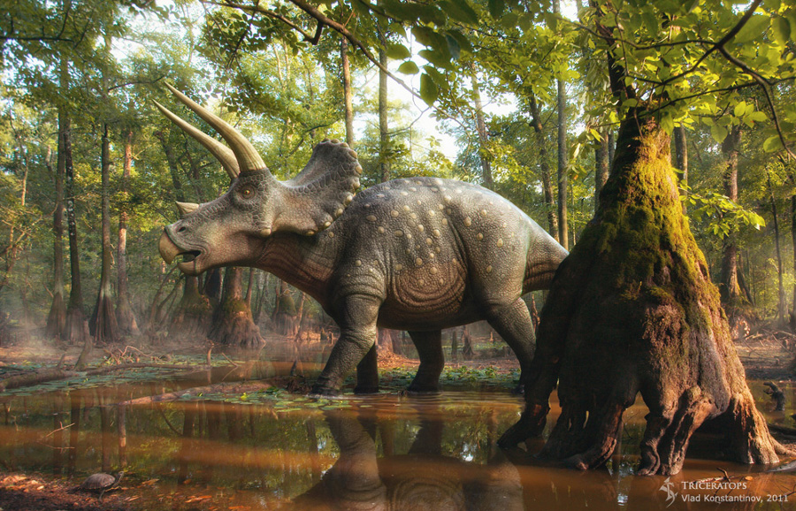
triceratops
Lived during Jurassic Period
Shoulders and hips place
legs beneath body
Adapted for life on land

Slide 22
Triceratops: cows of the cretaceous
Dinomite
Woody Alan
Braylynn
Woody Alan
Kaity
Karma
Blue Devil
Sage
Chelsea Bell

Slide 27
Pachycephalosaur
Lived during Jurassic Period
Shoulders and hips place
legs beneath body
Adapted for life on land

Slide 28
t. rex
Lived during Jurassic Period
Shoulders and hips place
legs beneath body
Adapted for life on land

Slide 31
t. rex

Slide 36
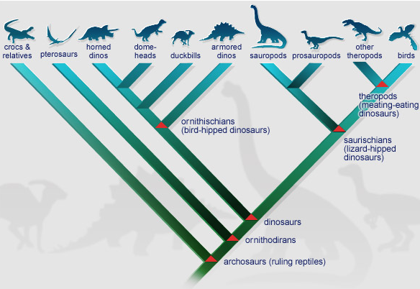
Dinosaur Family Tree- Cladistics Approach

Slide 37
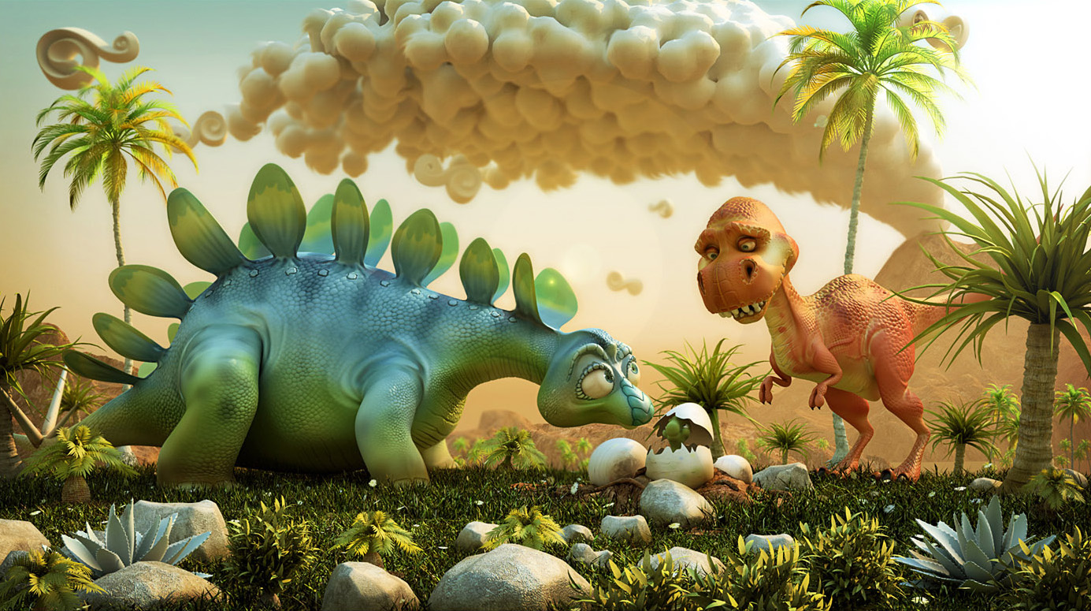
Now it’s gonna get fun!

Slide 38
Dinosaur Systematics Superorder: Dinosauria
Order Saurischia
Suborder Theropoda
Suborder Sauropoda
Order Ornithischia
Suborder Marginocephalia
Suborder Ornithopoda
Suborder Thyreophora

Slide 39
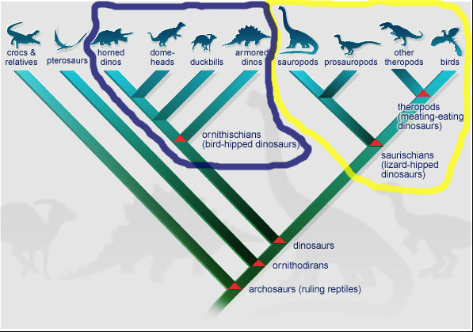
It’s Simple: 2 Dinosaur Orders

Slide 40
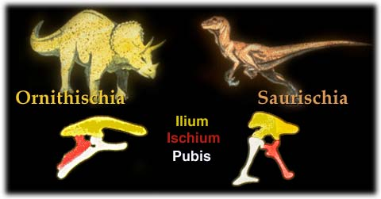
2 Dinosaur Orders
Saurischia- ‘Lizard-hipped’ dinosaurs
Ornithischia- ‘Bird-hipped’ dinosaurs
Which do you think are the closest relatives to birds?

Slide 41
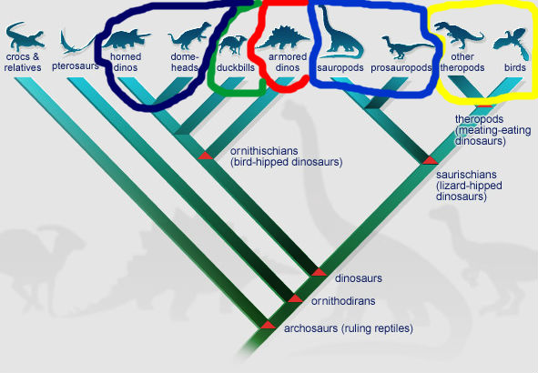
5 Dinosaur Suborders…

Slide 42
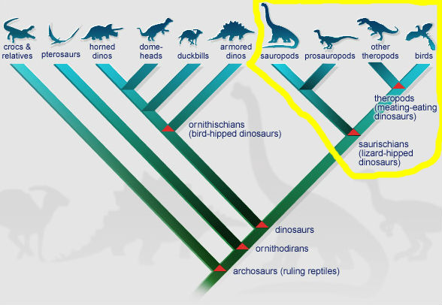
Order: Saurischia Suborders: Theropoda, Sauropoda

Slide 43
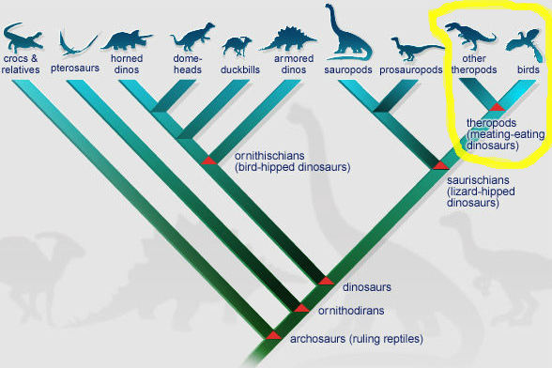
Order: Saurischia
Suborder: Theropoda (beast foot)

Slide 44
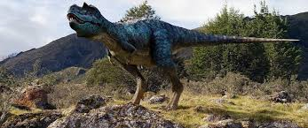
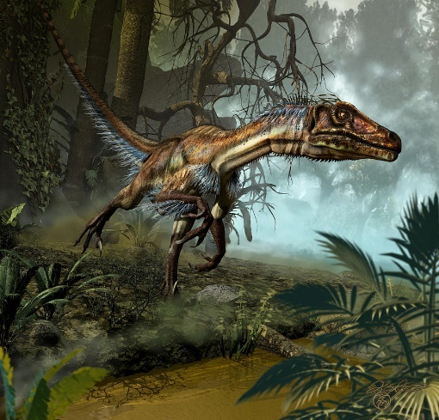
Theropods
Carnivorous dinosaurs
Walked on 2-legs (bipedal)
Includes: T. rex, Allosaurus, Spinosaurus, raptors
and…..birds

Slide 45
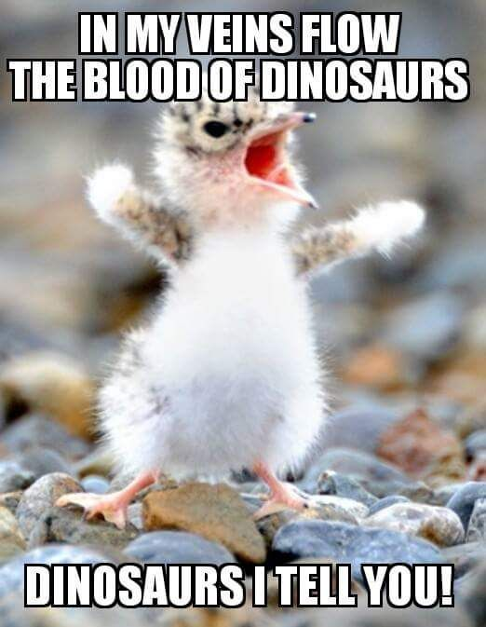
… Yes Birds

Slide 46
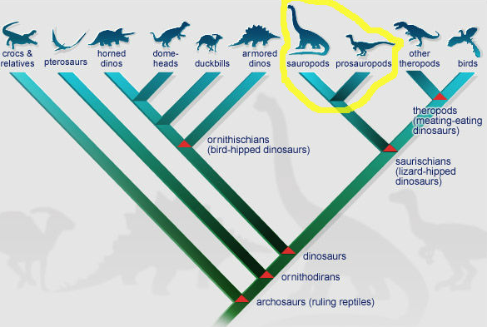
Order: Saurischia Suborder: Sauropoda (lizard foot)

Slide 47
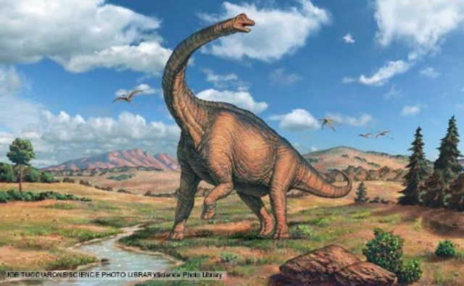
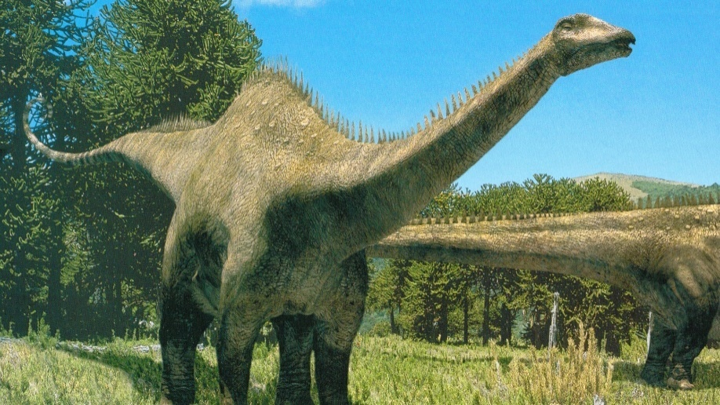
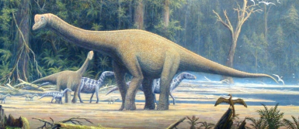
Sauropods
Traditional long-necked dinosaurs
Herbivores
Walked on 4-legs (quadrupedal) mostly
Includes: Diplodocus, Seismosaurus, Brachiosaurus, Brontosaurus and Apatosaurus

Slide 48
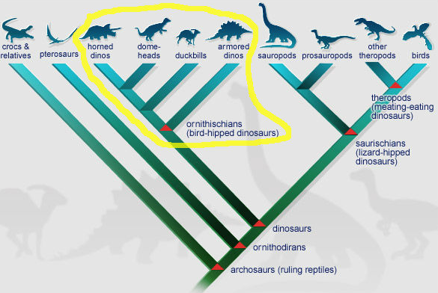
Order: Ornithischia 3 Suborders: THYREOPHORA, Ornithopoda, mARGINOCEPHALIA

Slide 49
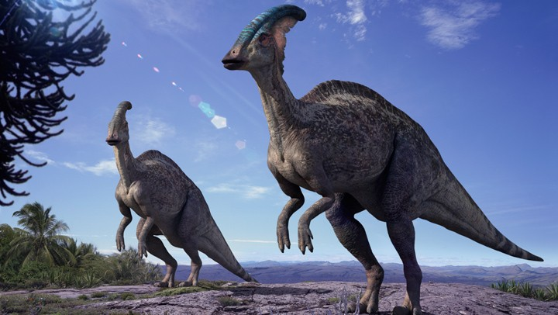
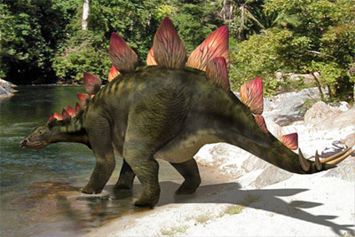
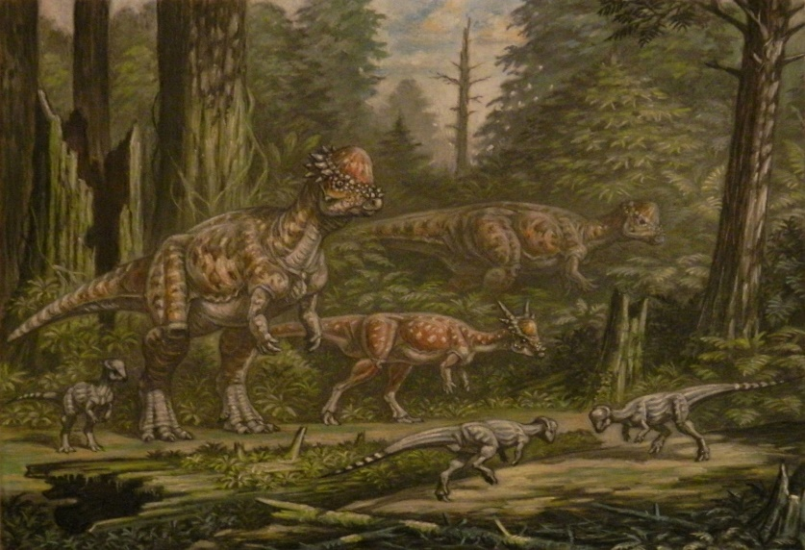
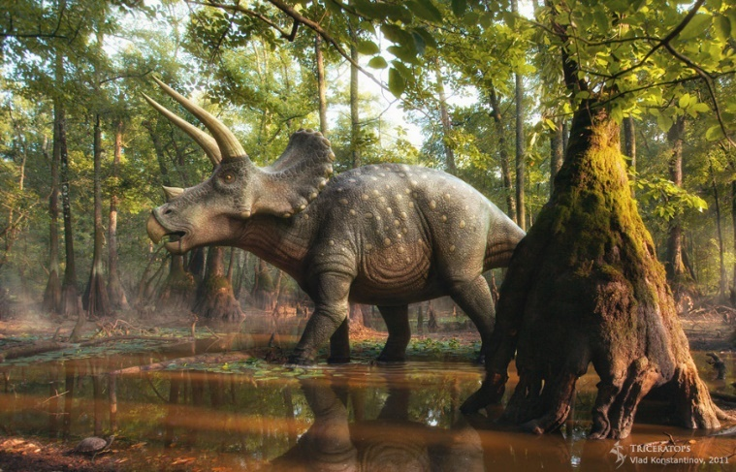
Ornithischia
Herbivores
Often have beaks or bills
Primarily walked on 4 legs (quadrupedal)

Slide 50
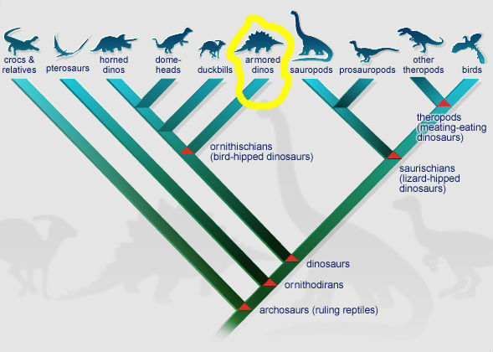
Suborder: Thyreophora

Slide 51
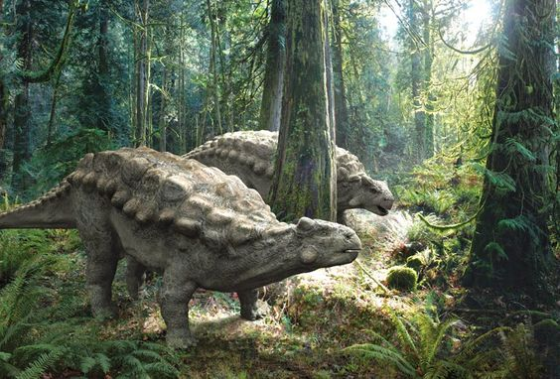
Suborder: Thyreophora
Armored or plated bodies
Spiked or clubbed tails
Ankylosaurs
Stegosaurs

Slide 52
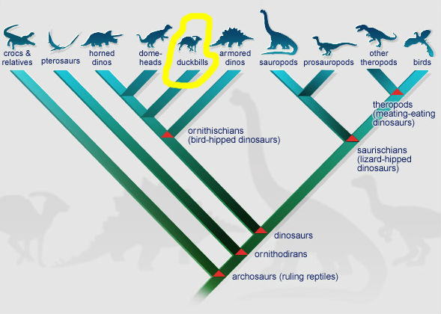
Suborder: Ornithopoda

Slide 53
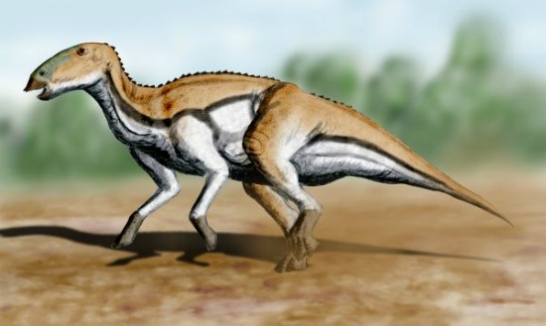
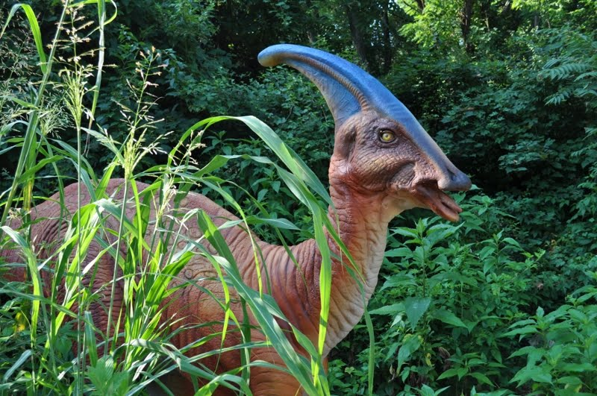
Suborder: Ornithopods Duck-billed Dinosaurs
Snout in shape of a bill
Large herds
Well known for nesting and rearing behaviors

Slide 54
Suborder: Marginocephalia Horned and Thick-Skulled Dinosaurs

Slide 55
Suborder: Marginocephalia Horned and Thick-Skulled Dinosaurs
Adaptations around the margin of the head
Frill, horns, thick-bony domes
Ceratopsians
Pachycephalosaurs

Slide 56
Describe-Your-Dino
Your field group just found a new species!
Journal the characteristics (complete the worksheet) of the fossil material at your site (table)
Can you determine:
What environment the animal lived in
When it lived
What it ate
Note any other interesting facts regarding the material
Where does the animal fit in the dinosaur world?

Slide 72
Evolution of Flight

Slide 73
Gliding

Slide 74
Running/Jumping

